Slide 1
Rekey Tool
- Mukul Debnath

Slide 2
Rekey Tool
An automation developed to speed up the artifacts rekey process from one release to another.
Basic Principle - XML based artifacts between two releases are merged. In place of conflicts, UI will display the conflict and after user intervention the XML will be merged.
This tool currently supports rekey of Workflow & Data Map
The code is developed in Java.
CONFIDENTIAL© Copyright 2007 Tech Mahindra Limited

Slide 3
Rekey – DataMap Artifact
CONFIDENTIAL© Copyright 2007 Tech Mahindra Limited

Slide 4
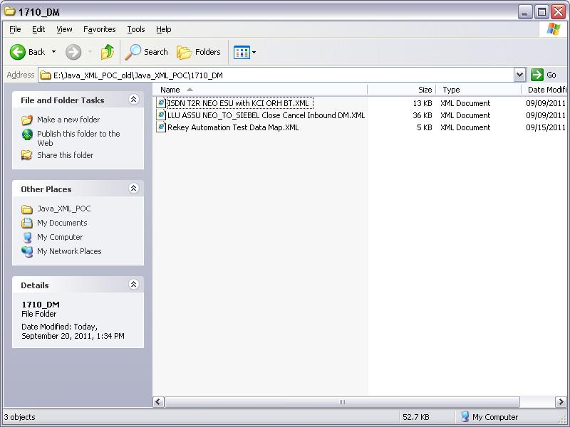
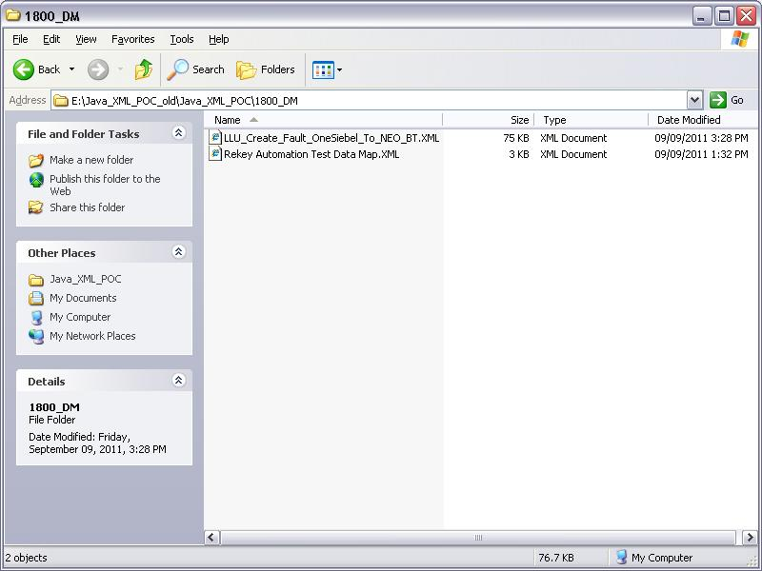
Rekey Tool – Data map Example
Higher Ver FLDR - 1800 Data Map folder
Lower Ver Fldr - 1710 Data Map folder
CONFIDENTIAL© Copyright 2007 Tech Mahindra Limited

Slide 5
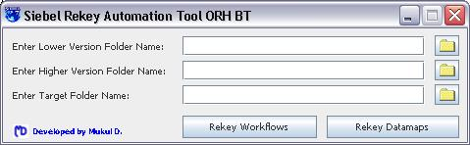
Rekey Tool – Data Map
I-Home Page
Browse buttons to select the Higher version folder name
Browse buttons to select the Lower version folder name
Browse buttons to select the target folder name

Slide 6
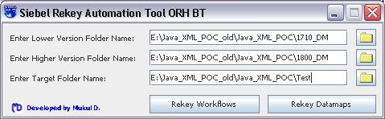
Rekey Tool – Data Map
II-After Selection
Target folder where the rekeyed artifacts will be placed.
This will rekey all the data maps from 1710 and 1800 and place the final data map in the target folder.
CONFIDENTIAL© Copyright 2007 Tech Mahindra Limited

Slide 7
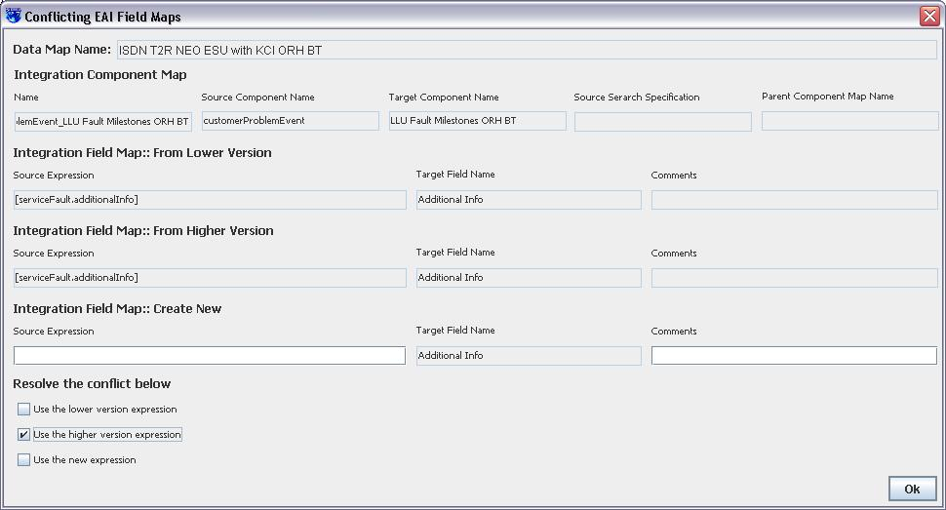
Rekey Tool – Data Map
III-Conflict Resolution[Source Expr – Field Mapping]
This UI will pop up.
Incase of conflict in Field Mapping, values from the lower version
Values from the higher version
Option to enter new values
Options to select
CONFIDENTIAL© Copyright 2007 Tech Mahindra Limited

Slide 8
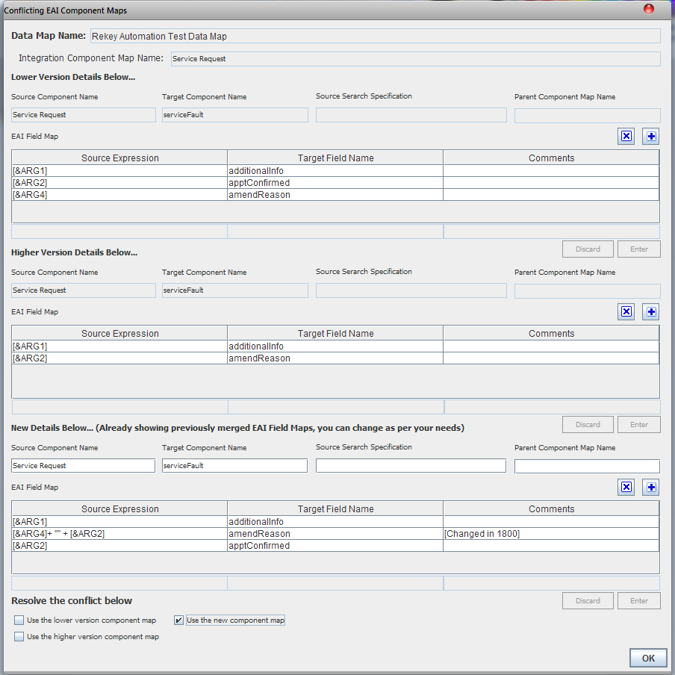
Rekey Tool – Data map Example
III-Conflict Resolution[Component Map]
Options to add/delete Field mappings
Options to select
CONFIDENTIAL© Copyright 2007 Tech Mahindra Limited

Slide 9
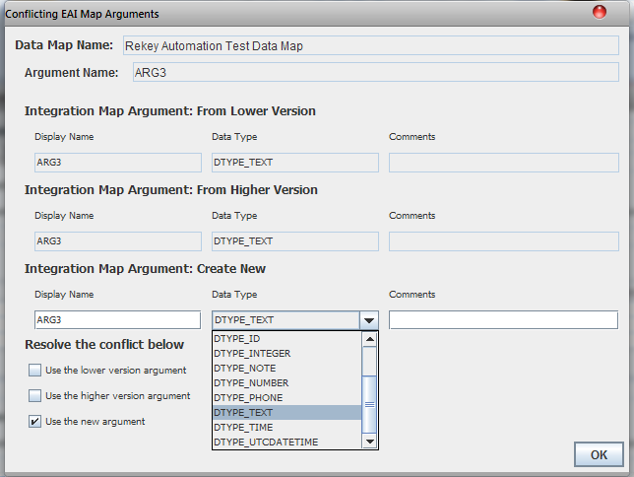
Rekey Tool – Data Map
III-Conflict Resolution[Map Argument]
Options to select
CONFIDENTIAL© Copyright 2007 Tech Mahindra Limited

Slide 10
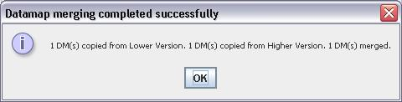
Rekey Tool – Data Map
IV-Output
CONFIDENTIAL© Copyright 2007 Tech Mahindra Limited

Slide 11
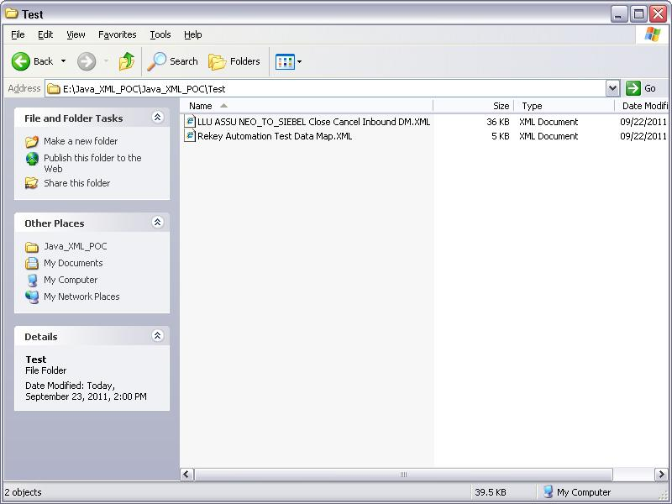
Rekey Tool – Data Map
IV-Output
Rekeyed Data maps in the target folder
CONFIDENTIAL© Copyright 2007 Tech Mahindra Limited

Slide 12
Rekey – Workflow Artifact
CONFIDENTIAL© Copyright 2007 Tech Mahindra Limited

Slide 13
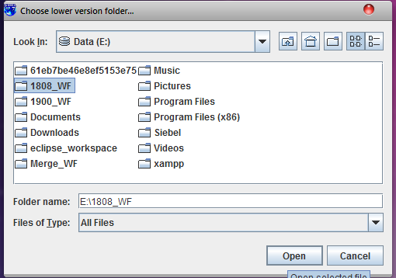
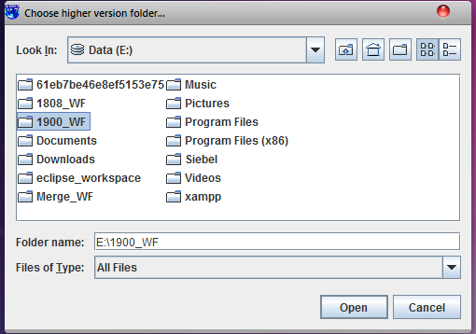
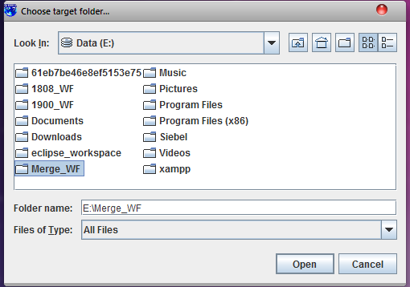
Rekey Tool – Workflow
Lower Ver FLDR - 1800 WF folder
Higher Ver FLDR - 1900 WF folder
Target WF FLDR after merge
CONFIDENTIAL© Copyright 2007 Tech Mahindra Limited

Slide 14
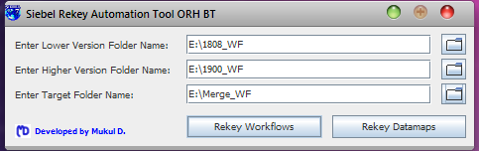
Rekey Tool – Workflow
II-After Selection
Target folder where the rekeyed artifacts will be placed.
This will rekey all the WF’s from 1808 and 1900 and place the final WF in the target folder.
CONFIDENTIAL© Copyright 2007 Tech Mahindra Limited

Slide 15
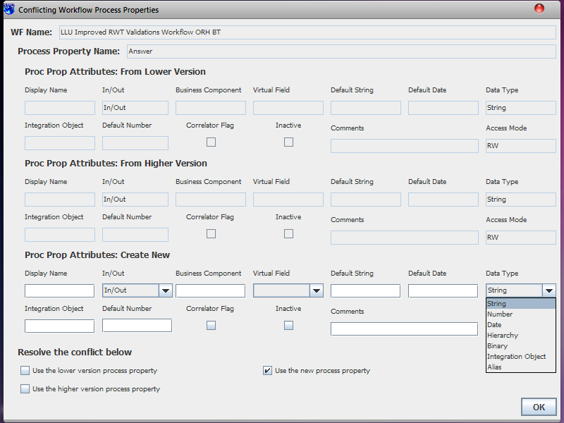
Rekey Tool – Workflow
III-Conflict Resolution[Process Property]
Process Property details from Lower version`
Process Property Name.`
Process Property details from Higher version`
New Process property creation`
Resolve Conflicts
CONFIDENTIAL© Copyright 2007 Tech Mahindra Limited

Slide 16
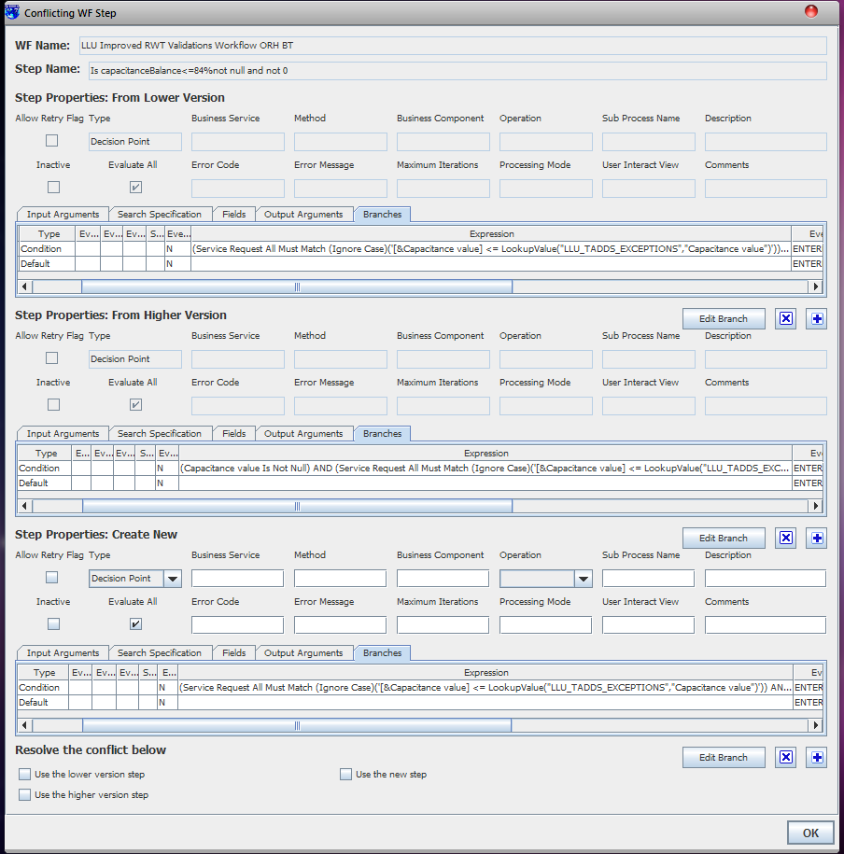
Rekey Tool – Workflow
III-Conflict Resolution[WF Step]
Details of the step from lower version
WF step name.`
All the properties of steps exactly the way it is in Siebel WF(I/p argument,Search Spec,Fields,O/p Argumen/Branches)
Details of the step from higher version
Facility to create new Step
Resolve Conflicts
CONFIDENTIAL© Copyright 2007 Tech Mahindra Limited

Slide 17
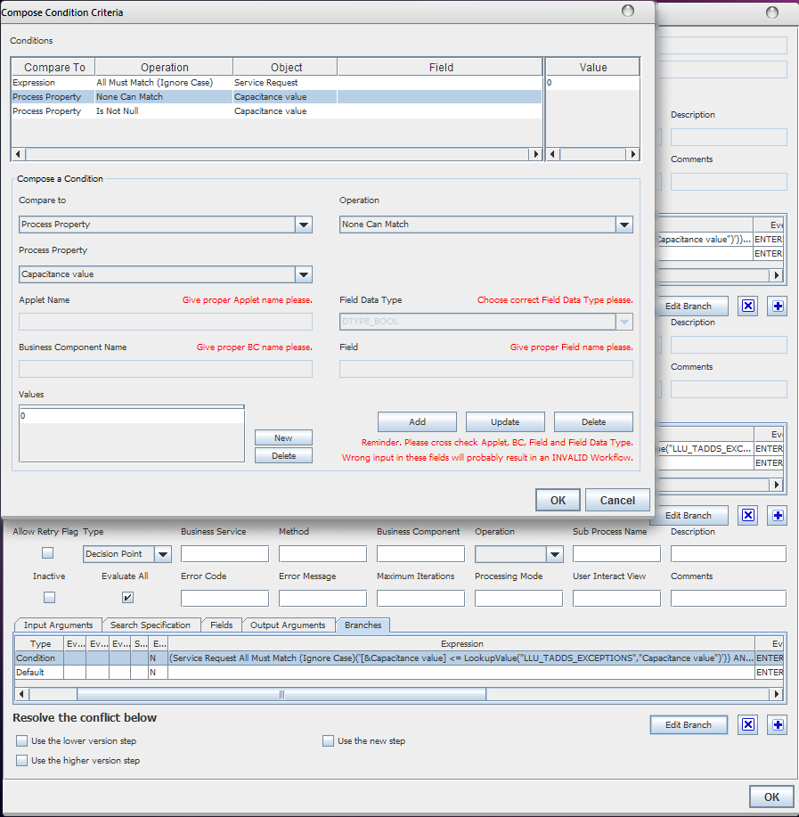
Rekey Tool – Workflow Example
III-Conflict Resolution[WF Step – Branches]
Branch conflicts are shown here
Additional facility to change Branch conflicts.
CONFIDENTIAL© Copyright 2007 Tech Mahindra Limited

Slide 18
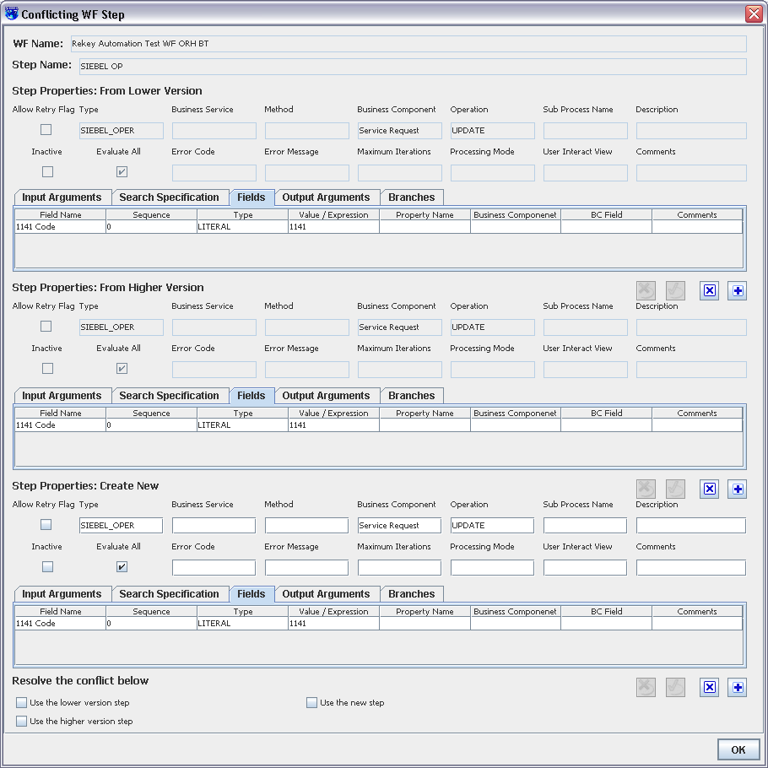
Rekey Tool – Workflow
III-Conflict Resolution[WF Step – Fields]
Field details of a step
CONFIDENTIAL© Copyright 2007 Tech Mahindra Limited

Slide 19
Rekey Tool – Workflow
III-Conflict Resolution[WF Step – Fields]
Field details of a step
CONFIDENTIAL© Copyright 2007 Tech Mahindra Limited

Slide 20
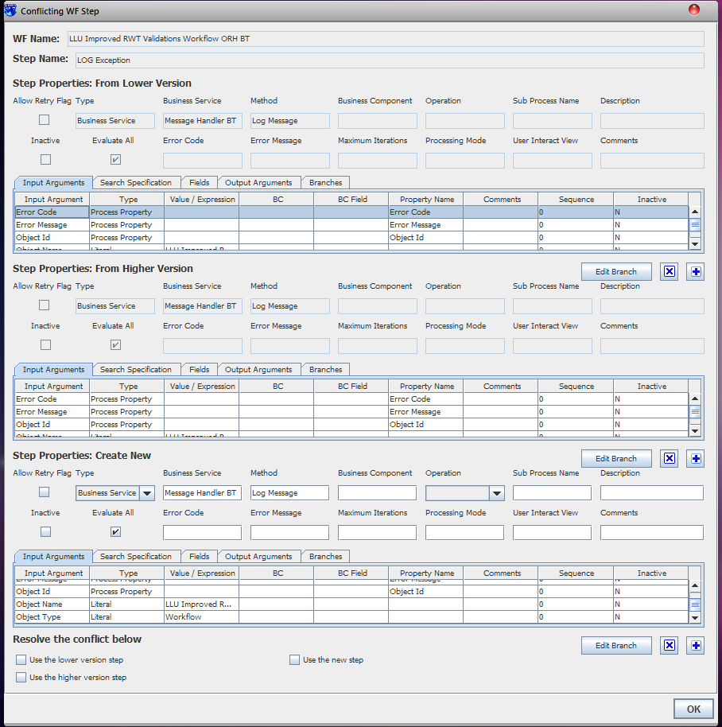
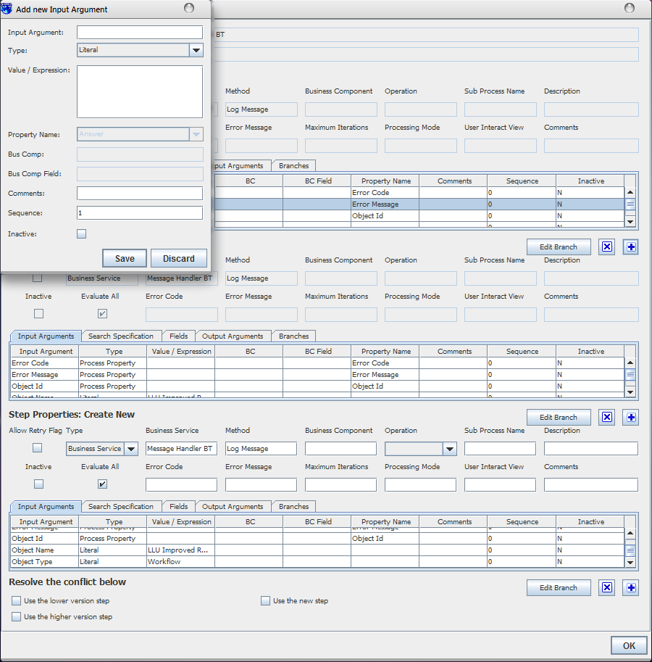
Rekey Tool – Workflow
III-Conflict Resolution[WF Step – I/p arguments]
I/p arguments
Facility to add new I/P argument
CONFIDENTIAL© Copyright 2007 Tech Mahindra Limited

Slide 21
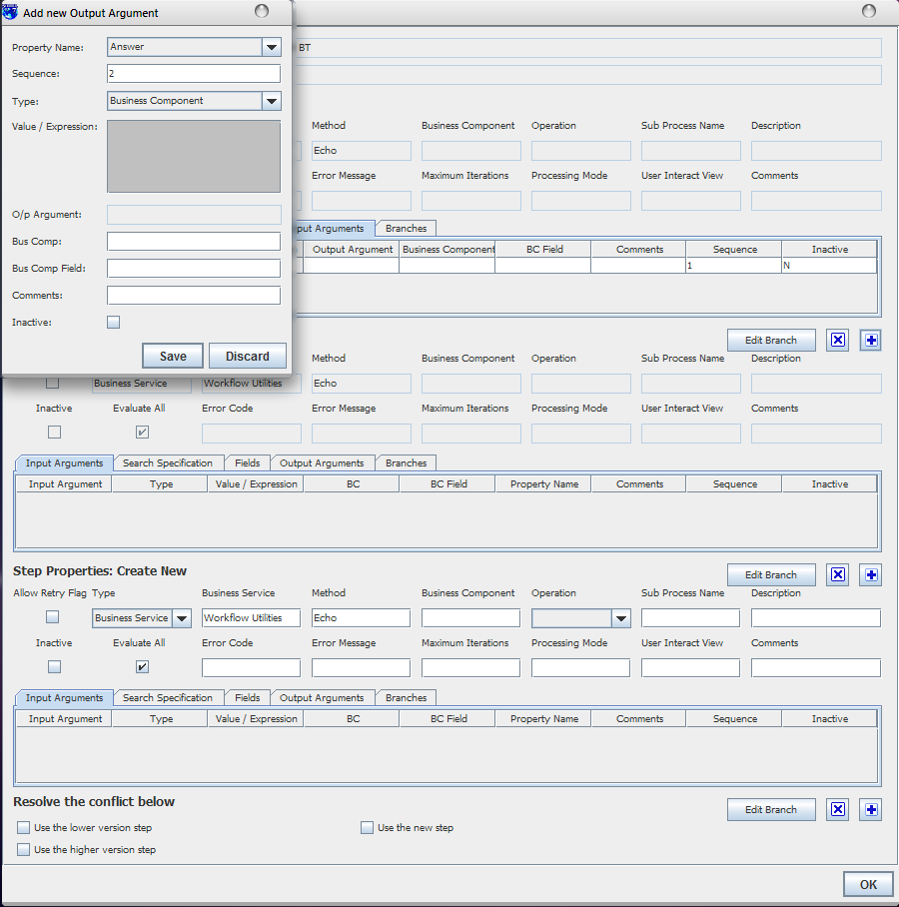
Rekey Tool – Workflow
III-Conflict Resolution[WF Step – O/p arguments]
Facility to add new O/P argument
CONFIDENTIAL© Copyright 2007 Tech Mahindra Limited

Slide 22
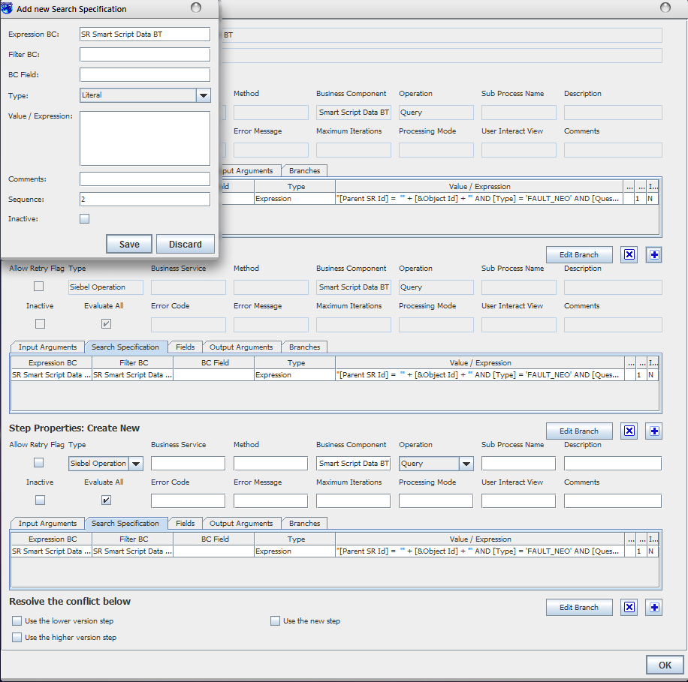
Rekey Tool – Workflow
III-Conflict Resolution[WF Step – Search Spec]
Facility to create new Search Specs
CONFIDENTIAL© Copyright 2007 Tech Mahindra Limited

Slide 23
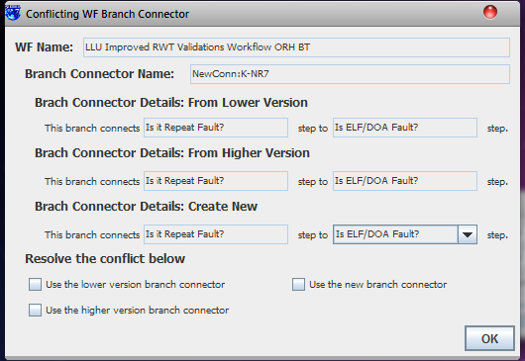
Rekey Tool – Workflow
III-Conflict Resolution[Branch Connector]
In case of conflicts in branch connectors – Branch Name
Branch Details from lower version
Branch Details from higher version
New branch details
Resolve Confict
CONFIDENTIAL© Copyright 2007 Tech Mahindra Limited

Slide 24
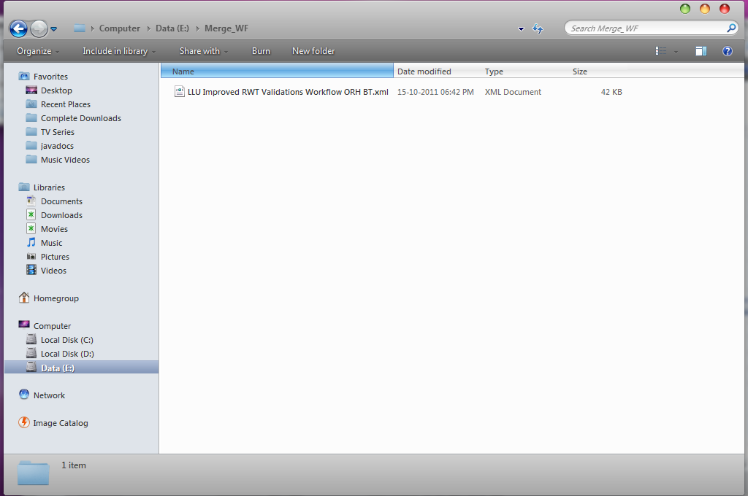
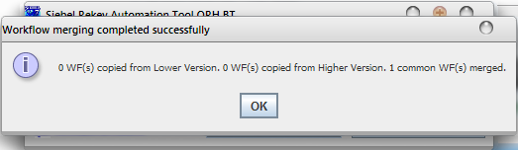
Rekey Tool – Workflow
WF Merge Result
Merged WF in target directory
CONFIDENTIAL© Copyright 2007 Tech Mahindra Limited

Slide 25
Thanks
CONFIDENTIAL© Copyright 2007 Tech Mahindra Limited

